Slide 1
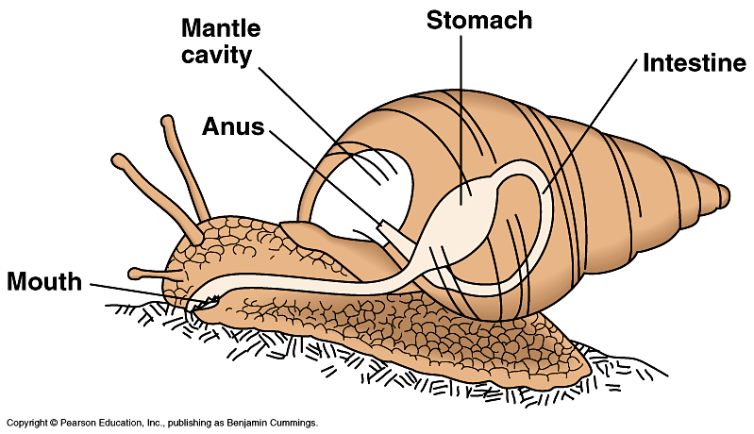
MOLLUSCA:
GENERAL FEATURES, CLASSIFICATION & EXAMPLES
Dr. R. Debnath
Associate Professor
Deptt. of Zoology
MBB College, Agartala
07/03/2019

Slide 2
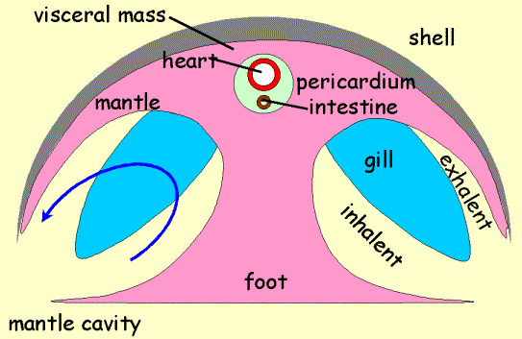
Mollusc Body Plan

Slide 3
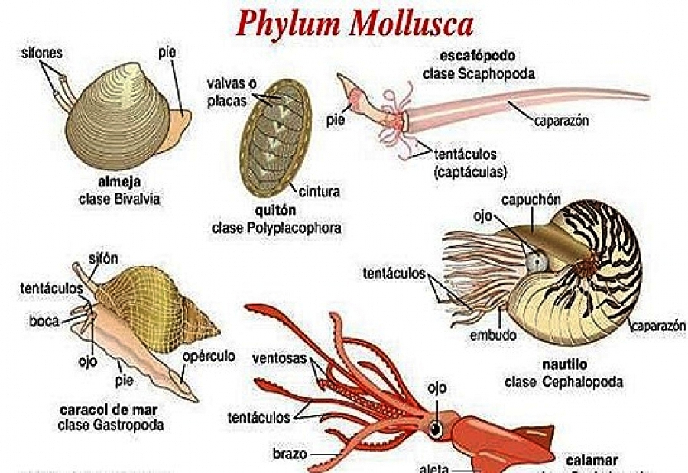

Slide 4
Phylum Mollusca
Second-largest phylum in number of species- over 100,000 described.
Ecologically widespread- marine, freshwater, terrestrial (gastropods very successful on land)
Variety of body plans (therefore, many classes within the phylum)
Variety in body size- from ~1 mm to ~18 m (60 feet). 80% are under 5 cm, but many are large and therefore significant as food for man.

Slide 5
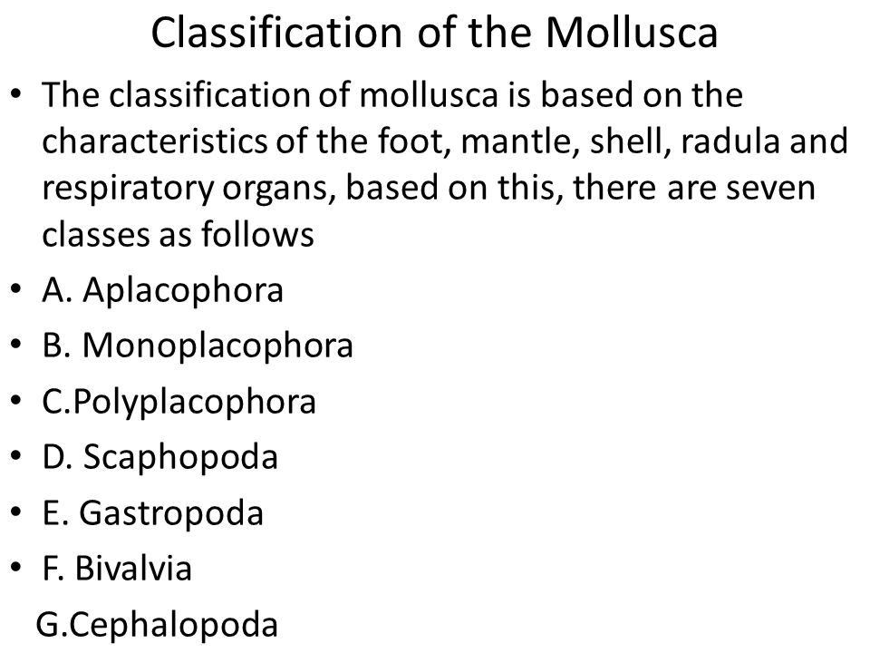
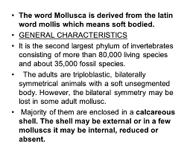
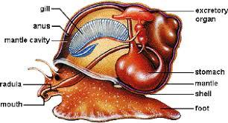
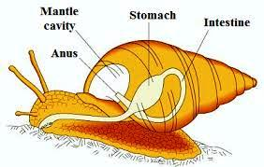

Slide 6
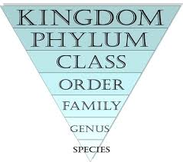
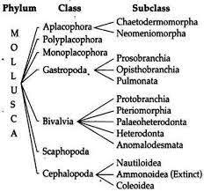
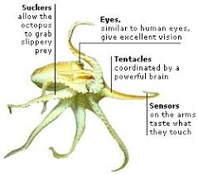

Slide 7
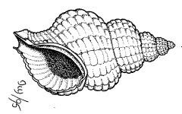
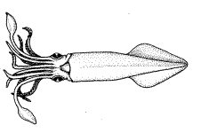
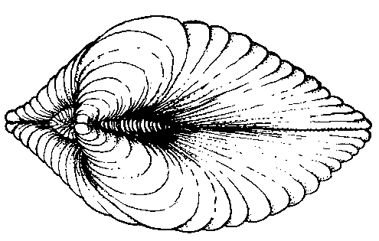

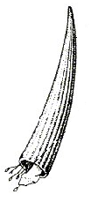
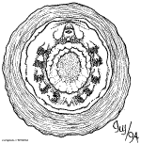
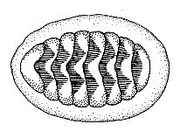
7 Classes of Extant Molluscs
5. Gastropoda
(snails)
7. Cephalopoda
(octopus, squid,
nautilus)
6. Bivalvia
(clams, mussels)
1.Aplacophora
3. Polyplacophora
(chitons)
2. Monoplacophora
  4. Scaphopoda
  (tusk shells)

Slide 8
There are seven (7) mollusc classes:
Those 7 classes are:
  1. Monoplacophora (mono=single; placo=shell; phora=bearing)
    Ex. Neopilina galatheae
  2. Aplacophora (a=without)
    Ex. Neomenia, Chaetoderma
  3. Polyplacophora (poly=many)
    Ex. Chiton, Amicula
  4. Scaphopoda (Gr.skáphē = boat, poda=foot))
  Ex. Dentalium, Cadulus
  5. Gastropoda (gastro=body cavity; poda=foot)
    Ex. All snails, conches, cowries etc (Pila, Achatina, Aplysia, Helix, Limax, Doris, Monetaria etc)
  6. Bivalvia (bi=two; valvia=valves)
    Ex. All clams, oysters, jhinuk etc (Nucula, Lammellidens, Pinctada, Mytilus, Pandora etc)
  7. Cephalopoda (cephalo=dealing with head; poda=foot)
    Ex. Squid, octopus, etc.(Nautilus, Sepia, Loligo, Octopus etc)

Slide 9
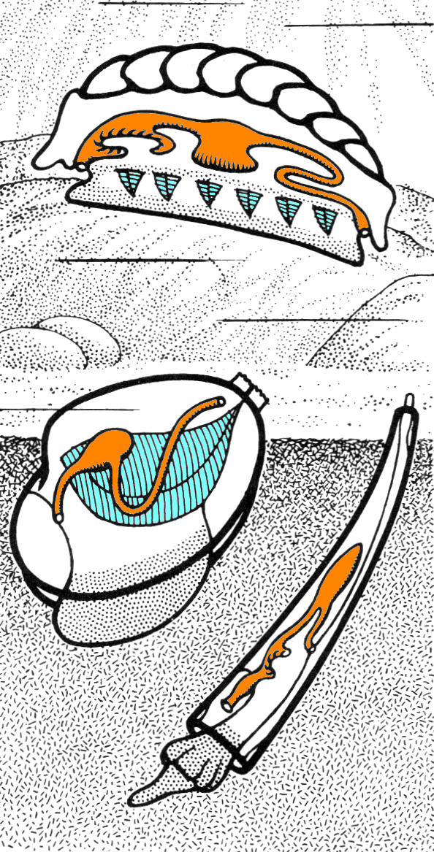
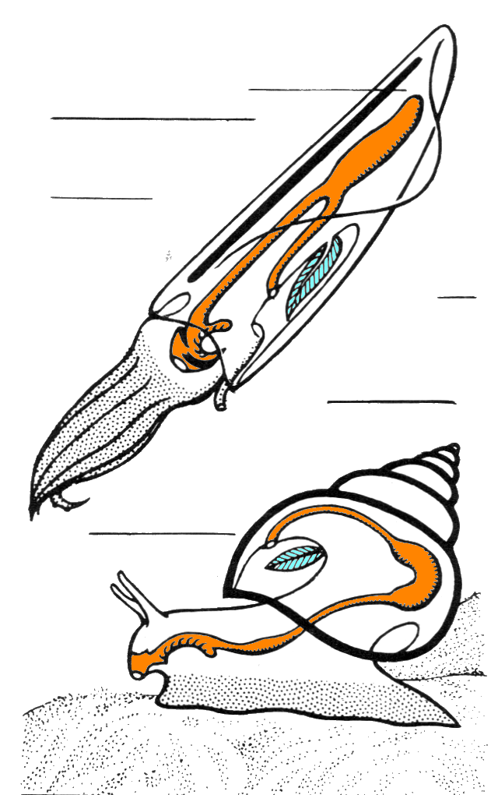
Nearly all parts of SQUIDS, CALAMARI and CUTTLEFISHES are edible, including the bodies (known as 'hoods' 'tubes' or 'mantles'), fins (or 'wings'), tentacles and the ink, which can be used to colour and flavour rice or pasta dishes.
Cuttlefish have a unique internal shell, the cuttlebone.
Cuttlefish have large, W-shaped pupils, eight arms, and two tentacles furnished with denticulated suckers, with which they secure their prey. They generally range in size from 15 to 25 cm (6 to 10 in), with the largest species, Sepia apama, reaching 50 cm (20 in).
Barring a few exceptions, octopuses have eight arms and no tentacles, while squid and cuttlefish have eight arms (or two "legs" and six "arms") and two tentacles.

Slide 10
Mollusk Characteristics
Ciliated body surface
Calcareous shell- composed of three primary layers- outer periostracum, middle prismatic layer (columnar crystals of calcite) and inner nacre (flat crystals of calcite)
Mantle- dorsal surface of body wall, modified to secrete shell
Radula- a rasping “tongue” with chitin teeth, sometimes also chitinous jaws
Ctenidia- ciliated gills for respiratory gas exchange, usually located in a mantle cavity
Open circulatory system (hemocoel)- coelom is reduced

Slide 11
Characteristics…..Cont’d
Free-living, multicellular animals
Invertebrates (lack a backbone)
Unsegmented
Have a true coelom
Bilateral symmetry
Have a true heart
Simple to complex nervous system

Slide 12
Habitats & Niches
Some mollusc habitats include:
  Marine (mostly)
  Freshwater (a few)
  Land (a few)
Mollusc niches (life-style):
  Most live on the ocean bottom and are mostly sedentary
  Some are free-swimming (the cephalopods)

Slide 13
Class Monoplacophora
Neopilina is the only genus in this entire class.
These creatures were discovered in the 1950s while dredging the deep ocean. Specifically, they can be found around South & Central America.
Prior to 1952 only fossil records were found.
Their specific characteristics include:
  Single shell
  Broad, rounded foot
  Evidence of segmentation
    They have 5-6 pairs of gills & eights pairs of foot retractors.
    This segmentation suggests an ancestral relationship with annelids.

Slide 14
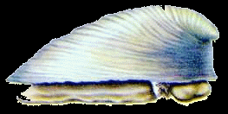
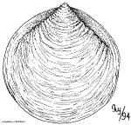
Class Monoplacophora (“single shell carriers”)
Originally described from fossils- thought to be extinct since Devonian (350 mya)
first live specimens recovered in 1952 from 3,600 m depth
Primitive class, most similar to polyplacophores ie. chitons
Organ systems show metamerism, similar to annelids and arthropods
Known as “Living fossil”

Slide 15
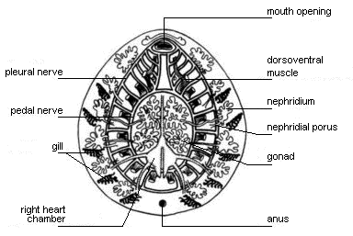
Class Monoplacophora
Neopilina galatheae
Neopilina galatheae is a living representa­tive of the class Monoplacophora. This newly discovered species possesses peculiar ad­mixture of molluscan and annelidan features. Neopilina is a very primitive member amongst the molluscs and represents a sort of connecting bridge between the annelids and molluscs.
It remains almost unchanged since 350 million years (Devonian Period)-hence called the living fossil.

Slide 16
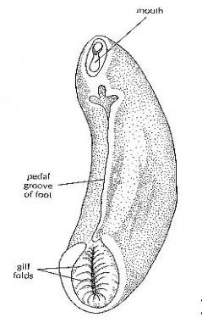
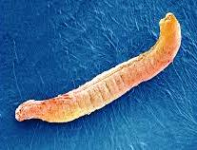
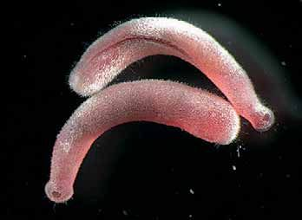
Class Aplacophora
Specific characteristics:
  Wormlike body
  No shell, but has a body wall made up of calcium spicules (think of the sponges).
    Now it is under phylum Mollusca
  They are generally found on the ocean floor.

Slide 17
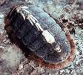
Class Polyplacophora
Chiton (C. magnificus etc) is the only genus in the class Polyplacophora.
Their specific characteristics:
  Posses a shell that consists of 8 overlapping plates.
  Thick mantle
  Broad foot
  Distinguishable head
  They have a tongue-like tooth-covered rasping organ (radula) to scrape algae and other food.

Slide 18
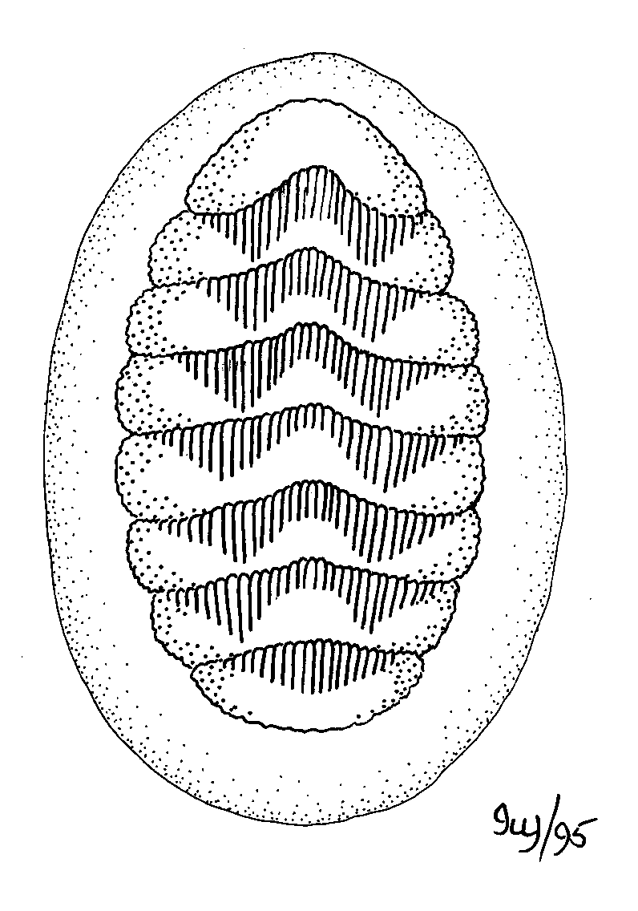
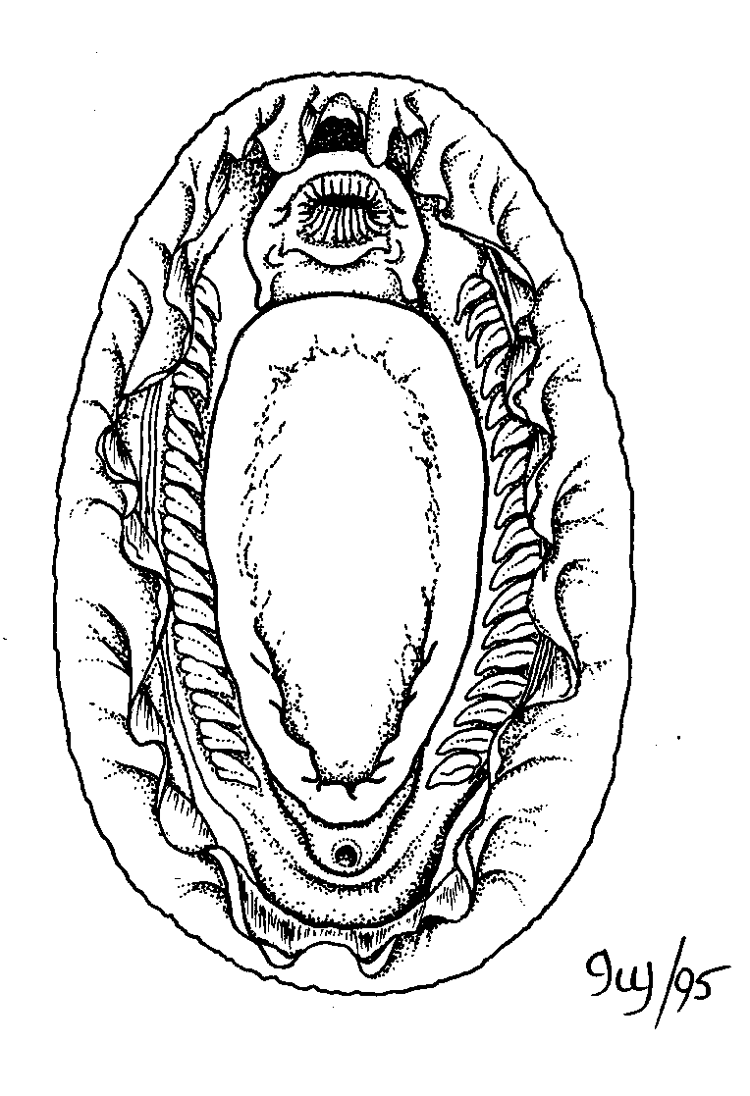
800 species, all marine, many intertidal
Shell is distinctive- 8 overlapping plates imbedded partly or entirely in tough “girdle”.
Mantle space extends around perimeter of animal (not just posterior).
Ctenidia are lateral and multiple.
Very conservative class.
Fossils date to mid/late Cambrian (500 my).

Slide 19
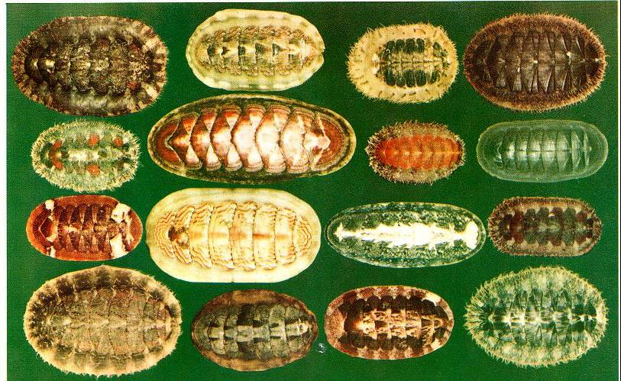
A collection of chitons
After a Chiton dies, the individual valves which make up the eight-part shell come apart because the girdle is no longer holding them together, and then the plates sometimes wash up in beach drift. The individual shell plates from a chiton are sometimes known as "butterfly shells" due to their shape. They are also sometimes known as sea cradles or "coat-of-mail shells", or more formally as loricates,

Slide 20
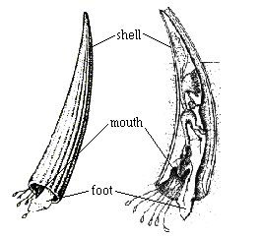
Class Scaphopoda
Class Scaphopoda
(Solenoconcha; tusk shells)
  Midventrally fused mantle and tubiform to barrel-shaped shell; head with tubular snout and 2 bunches of slender tentacles (captacula); foot pointed and cylindrical; no ctenidia and distinct blood vessels; no heart auricles; radula strong; microcarnivores; marine burrowers in soft sediments, in 0–7,000 m; 2 to 150 mm; about 350 species in 2 orders.
There are approximately 900 species of Scaphopoda, commonly called tusk shells. Single-shelled tusk-shaped mollusks, ranging from about an eighth of an inch (a few mm) to 7.8 in (20 cm) in length. Burrow into exclusively marine sediments with a muscular foot; feed on microorganisms with thin tentacular captacula (threadlike cilia-bearing organs).

Slide 21
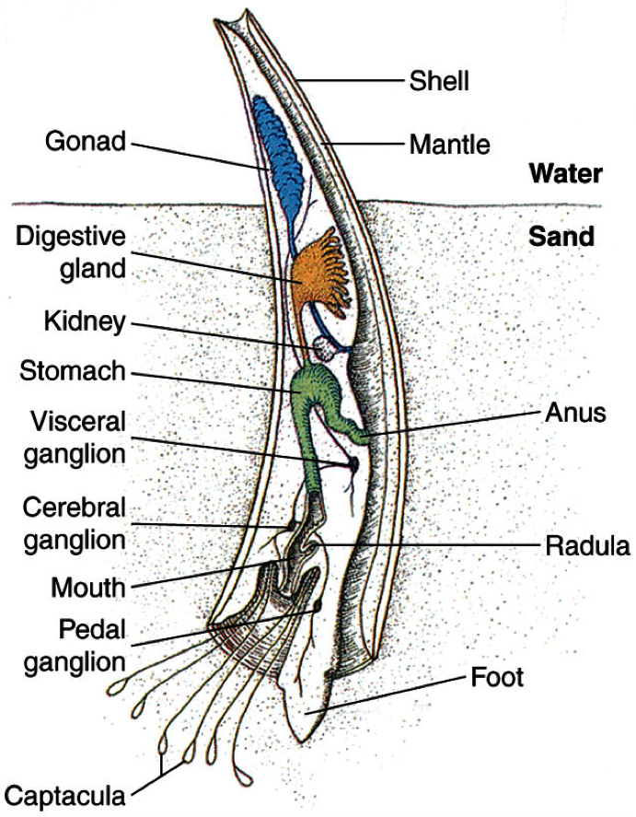
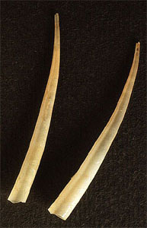

Slide 22
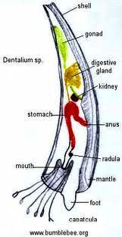
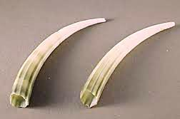
The shells of Dentalium hexagonum and Dentalium pretiosum were strung on thread and used by the natives of the Pacific Northwest as shell money. Dentalium shells were also used to make belts and headdresses by the Natufian culture of the Middle East, and are a possible indicator of early social stratification.

Slide 23
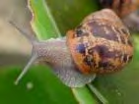
Class Gastropoda
  Most popular class of molluscs.
  Consists of snails and snail-like creatures.
  Specific characteristics:
    They have a dorsally located shell (often coiled).
    They have a well-developed radula.
  Visceral mass (organs) is located inside the shell. Their visceral mass is rotated 180 degrees during development.
  They are herbivores or predatory (carnivorous).
  Habitats include: ocean, lake, river bottoms, coastal shores, and land.

Slide 24
Class Gastropoda (“belly-foot”)
snails, slugs, nudibranchs, limpets, cowrys, abalones, etc.
By far the largest and most diverse molluscan class - over 80% of mollusc species are gastropods
Marine benthic, pelagic, freshwater benthic, terrestrial (mesic & xeric)
Grazers or predators
Prominent head, with well-developed sensory structures (second only to cephalopods)

Slide 25
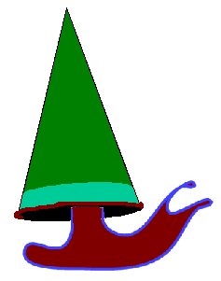
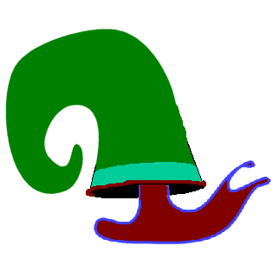
Gastropod shell
  Basically a calcareous cone, straight or coiled, with new shell deposited at the margin of the open end during growth
New growth
limpets
snails

Slide 26
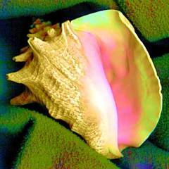
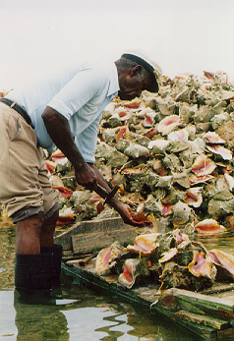
Gastropoda,
Prosobranchia,
Mesogastropoda
Example- conchs (Strombus ~50 species)
The queen conch (Strombus gigas) herbivorous- it is common in the Caribbean and is harvested for its meat and shell.
This species is economically important and of conservation concern due to overharvesting and pollution

Slide 27
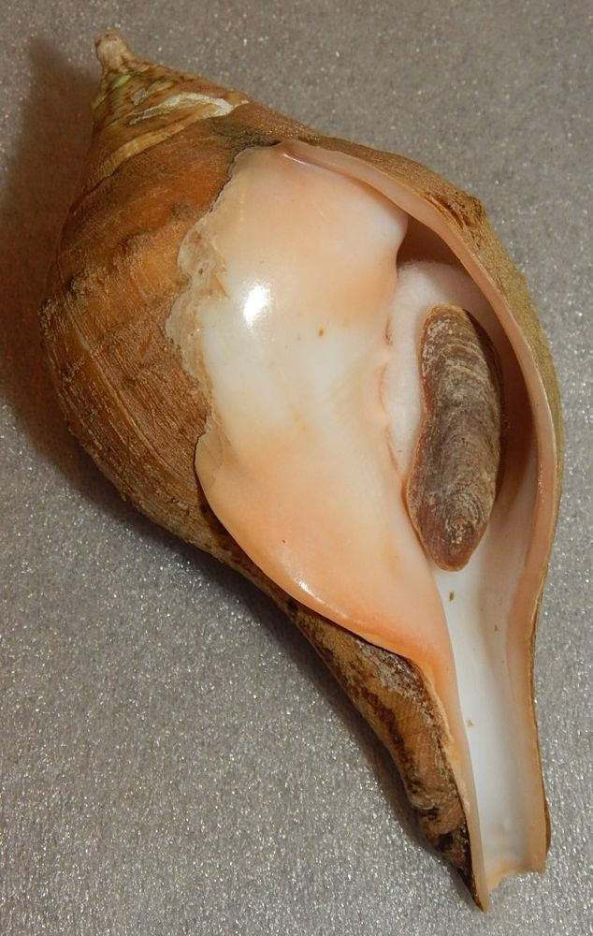
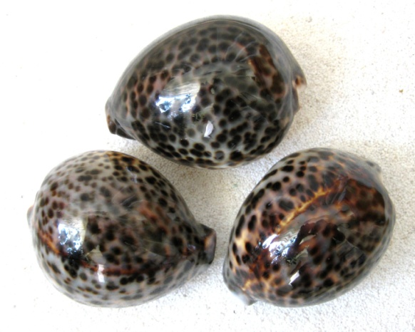
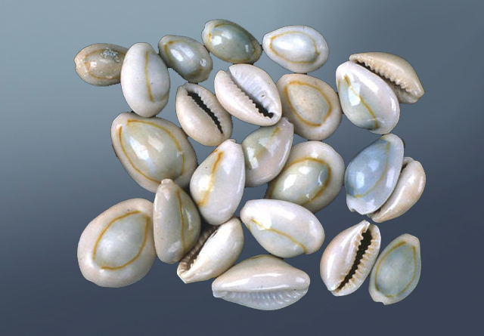
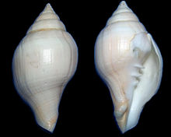
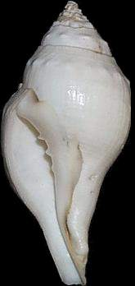
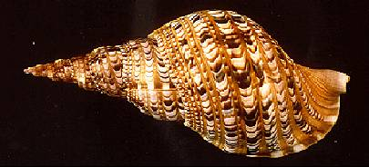
Mesogastropod prosobranchs
cowries
Monetaria moneta, M. annulus etc
tritons
Turbinella pyrum, the chank (Shankh) shell, sacred chank or Indian Divine Conch, also called Valampuri Sanggu; Sri Lakshmi Shankh

Slide 28
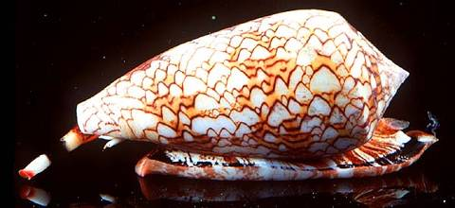
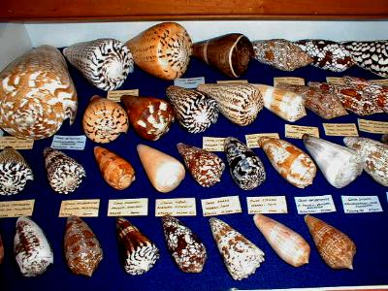
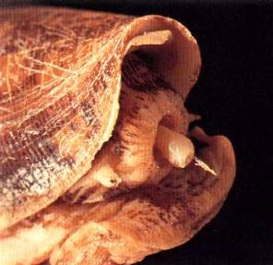
Gastropoda,
Prosobranchia,
Neogastropoda
Snails - Conus
500-1000 species.
All cone snails inject venom and several of the fish eaters can be fatal to humans

Slide 29
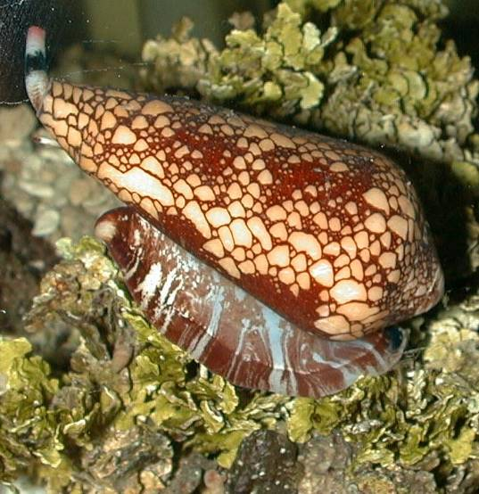
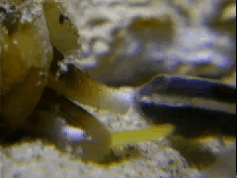
Cone snails
are able to engulf their prey whole after paralyzing it with venom

Slide 30
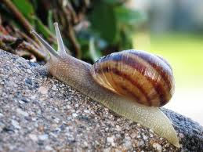

Cone snails have conotoxins:
unique venom strategy
  Many different small peptides target different receptors and enzymes. One species may have over 100 different peptides.
  Conotoxins have exceptionally high affinity for receptors and a very high target specificity.
  Great interest in these peptides as pharmacological agents for research and for drug use.

Slide 31




Some other neogastropod prosobranchs
Prosobranchs (Pros="forward"; branchia="gills") are a group of gastropod molluscs whose gills are located near the front of theirbody. Prosobranch susually possess a spirally coiled shell, but it is sometimes cap-shaped or tubular.
Volutes
Muricids
Whelks

Slide 32
Subclass Opisthobranchia (gills-behind)
some major groups by common name
Bubble snails (cephalaspids)
Sea slugs
  Nudibranchs: (dorids, aeolids) most are carnivorous, feed on cnidarians
  Sacoglossans: most are herbivorous- many adopt chloroplasts
  Pteropods: (thecosomes, gymnosomes) pelagic, foot modified into winglike lobes
Sea Hares: (anaspids) important in neurobiology

Slide 33
Nudibranchs (Order Nudibranchia)
  Shell, mantle cavity and ctenida are gone
  Possess cerata (singular = ceras) dorsal projections of the body wall and hemocoel that act as secondary gills
  Most are carnivorous and feed largely on cnidarian polyps.
  There are two suborders-
  Doridina (Doris) and Aeolidina (Aeolis).
  Nudibranchs are some of the most incredibly colorful animals on earth.

Slide 34


Borrowed weapons
  Aeolids feed on cnidarians and store the functional nematocysts at the tips of their cerata in cnidosacs
  Each ceras contains a branch of the digestive gland.
  A duct connects the cnidosac to the digestive gland.
Digestive gland
cnidosac
Stained section of cnidosac showing nematocysts at tip

Slide 35



Class Bivalvia
Specific Characteristics:
  They have no head.
  They have two shells held together by powerful muscles.
  They have a ventrally located foot that sticks out between the two valves.
  Habitats include: marine and freshwater.
  They tend to burrow into soft mud or sand or attach to rocks or other shells.
Large gills are used for respiration and filter feeding.
Food is trapped by mucus on the gills and moved by cilia. Water enters and exits through siphons.

Slide 36

Internal Anatomy of a Bivalve

Slide 37



Class Bivalvia
Clams, Oysters, Shipworms

Slide 38


Pinctada maxima is a species of pearl oyster, a marine bivalve mollusk in the family Pteriidae, the pearl oysters.
Pinctada is a genus of saltwater oysters, marine bivalve mollusks in the family Pteriidae, the pearl oysters. These oysters have a strong inner shell layer composed of nacre, also known as "mother of pearl".

Slide 39


Two shells
Most are filter feeders
No head or radula
Burrow
  Sand, wood, rocks
Notes:
Fig. 16.28b

Slide 40

Pearl formation
Shell
Developing pearl
Epithelium
Irritant lodged between shell and mantle
Layers of nacre secreted around foreign material

Slide 41



Scallops
Bay scallop
(Aequipecten irradians)

Slide 42



Scallop is a common name that is primarily applied to any one of numerous species of saltwater clams or marine bivalve mollusks in the taxonomic family ...

Slide 43


Class Cephalopoda
Contains the largest molluscs.
Specific Characteristics:
  May lack a shell (like an octopus)
  Shell may be reduced to a stiffening rod (like the squid or nautilus)
  The foot is highly modified to form a group of tentacles around the mouth.
  They are found in deep and shallow waters along many coasts.
  Squids & Nautilus are free-swimming and move very quickly. Octopuses are found among rocks or crawling on the bottom of the ocean.
  Complex brain, two lateral eyes, excellent eyesight.

Slide 44

Cuttle fish, Squids & Octopus
With the exception of nocturnal and very deep water cephalopods, all coeloids (squid, octopus and cuttlefish) which dwell in light conditions have an ink sac, which can be used to expel a cloud of dark ink in order to confuse predators. Melanogenesis in the ink gland of Sepia officinalis is a highly specialized organ with immature cells in the inner portion, from where the cells gradually mature, migrate towards the outer portion of the gland and become competent to produce melanin giving rise to particulate melanosomes.

Slide 45


They are not to be confused with the known giant Pacific octopus, which is a member of the genus Enteroctopus, and can grow to a total length of more than 6 m (20 ft). The gigantic octopus is assumed to be much larger.
Cuttlefish have a unique internal shell, the cuttlebone. ... Their predators incude dolphins, sharks, fish, seals, seabirds, and other cuttlefish.

Slide 46


Cephalopods vary enormously in size. The smallest are only about 1 centimetre (0.39 in) long and weigh less than 1 gram (0.035 oz) at maturity, while the largest—the giant (Architeuthis dux) and colossal squids (Mesonychoteuthis hamiltoni)—can exceed 10 metres (33 ft) in length and weigh close to half a tonne (1,100 lb), making them the largest living invertebrates. Cephalopods were at one time the largest of all organisms on Earth (Smith et al., 2016)…..

Slide 47


The giant Squid (Architeuthis) is a deep-ocean dwelling squid in the family Architeuthidae. Giant squid can grow to a tremendous size due to deep-sea gigantism: recent estimates put the maximum size at 13 m (43 ft) for females and 10 m (33 ft) for males from the posterior fins to the tip of the two long tentacles (second only to the colossal squid at an estimated 14 m (46 ft), one of the largest living organisms).

Slide 48



Rapid movement; well-developed nervous systems; highly developed eyes
Ex: Octopus, Squid, Nautilus

Slide 49
Visit to Samudrika, Port Blair, Andamans (2016) and Indian Sea Shell Museum, Mahabalipuram, Tamil Nadu (2018)…..a vast number of molluscan shells & specimens have been noticed….several photo-shoots were recorded…..a few are displayed herewith for your attention…..please note the huge diversity of mollusc shells !!

Slide 50

Mollusc Phylogeny
~50-80K extant species
~40K extinct species
Fossil records from Precambrian period of Proterozoic eon (>570my =
57 or 60 crores years BP)
THANKS FOR YOUR PATIENCE:
Attention & Devotion
10.03.2019

