Slide 1
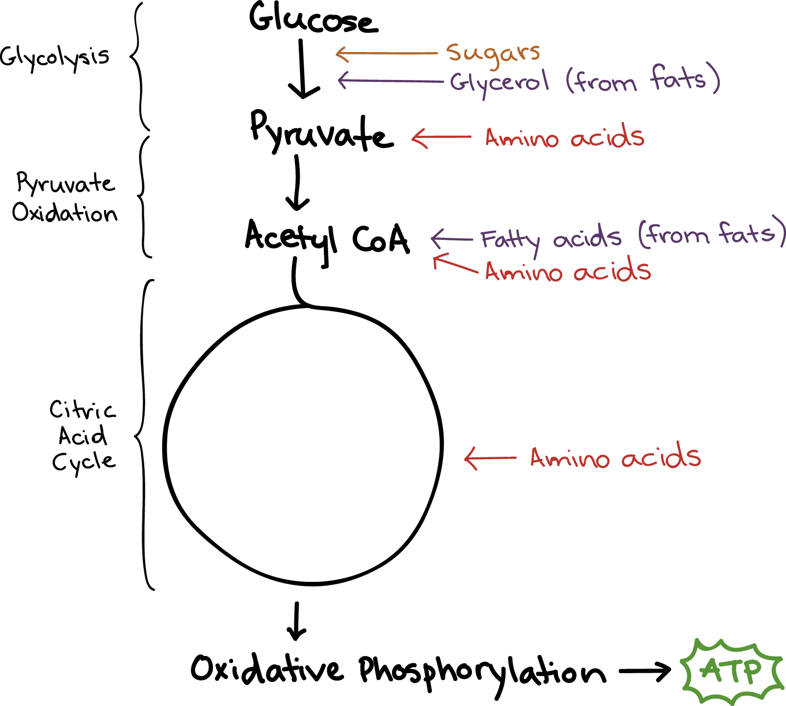
How Cells Harvest Energy
Dr. R. Debnath
Associate Professor
Deptt. of Zoology
MBB College
Agartala
Date: 06/05/2019

Slide 2
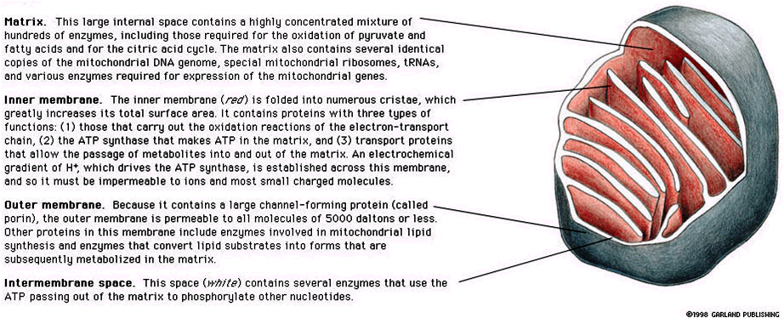
Sectional view of Mitochondrion showing its parts

Slide 3
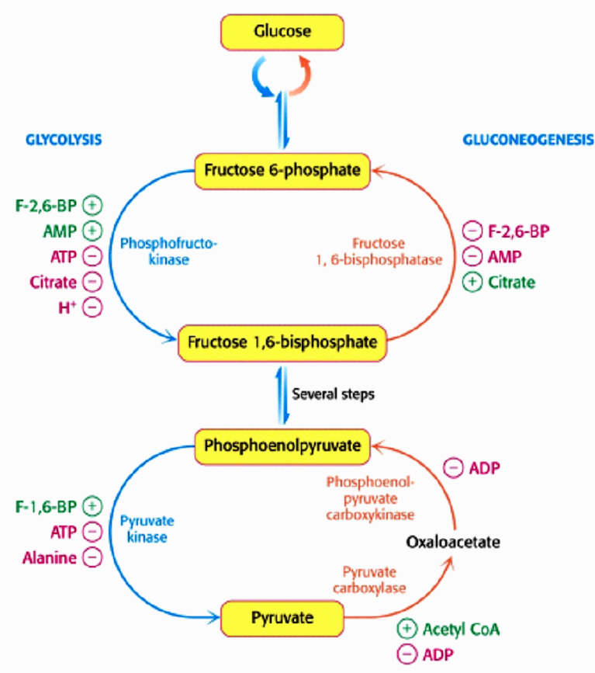
Relatonship between Glycolysis & Gluconeogenesis

Slide 4
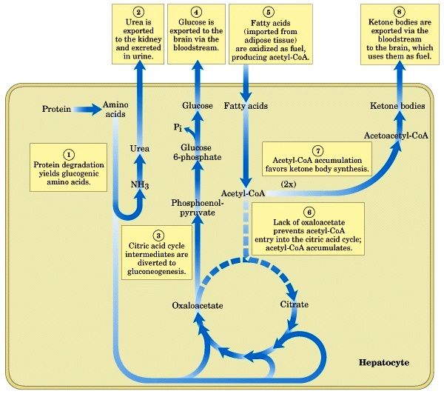
Metabolic Integration

Slide 5
Cellular Respiration
Cellular Respiration
(E) Regulation of pathways through feedback inhibition
(A) Role of ATP & Phosphorylation
(B)
The metabolic pathway of respiration: Glycolysis and the citric acid cycle
(C) The metabolic pathway of respiration: electron transport chain & ATP synthesis
(D)
Substrates for Respiration

Slide 6
Respiration
1. Organisms can be classified based on how they obtain energy:
autotrophs: are able to produce their own organic molecules through photosynthesis
heterotrophs: live on organic compounds produced by other organisms
2. All organisms use cellular respiration to extract energy from organic molecules.

Slide 7
Respiration
3. Cellular respiration is a series of reactions that:
-are oxidations – loss of electrons
-are also dehydrogenations – lost electrons are accompanied by hydrogen.
4. Therefore, what is actually lost is a hydrogen atom (1 electron, 1proton).
5. During redox reactions, electrons carry energy from one molecule to another.
6. NAD⁺ is an electron carrier.
-NAD accepts 2 electrons and 1 proton to become NADH
-the reaction is reversible

Slide 8
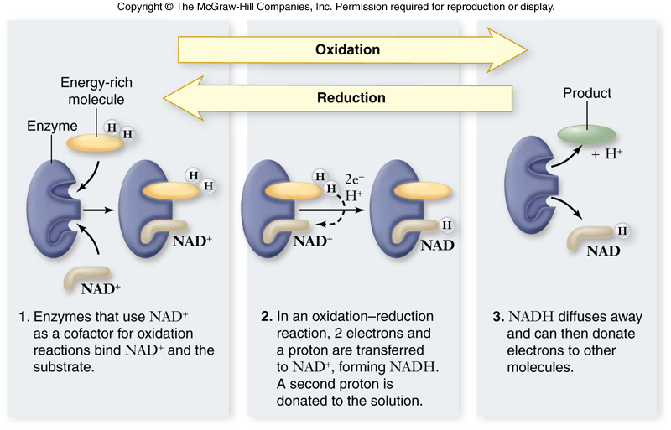

Slide 9
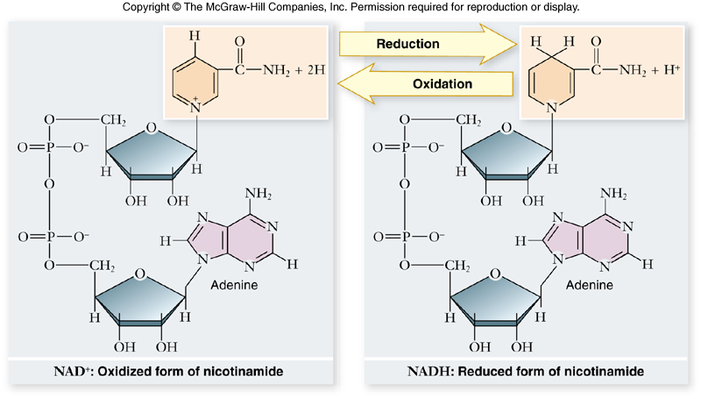

Slide 10
Respiration
During respiration, electrons are shuttled through electron carriers to a final electron acceptor.
aerobic respiration: final electron receptor is oxygen (O₂)
anaerobic respiration: final electron acceptor is an inorganic molecule (not O₂)
fermentation: final electron acceptor is an organic molecule

Slide 11
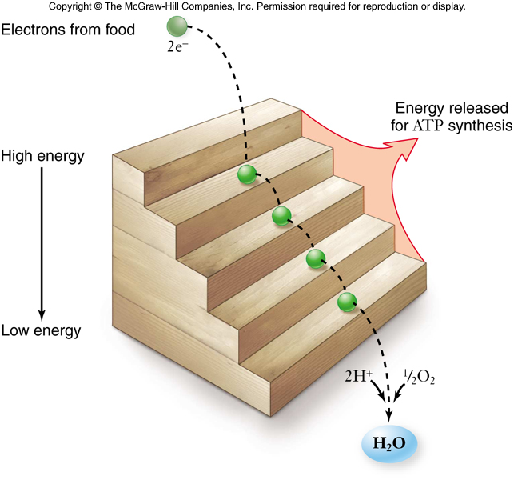

Slide 12
Respiration
Aerobic respiration:
C₆H₁₂O₆ + 6O₂ 6CO₂ + 6H₂O
ΔG = -686kcal/mol of glucose
ΔG can be even higher than this in a cell
This large amount of energy must be released in small steps rather than all at once.

Slide 13
Respiration
The goal of respiration is to produce ATP.
-energy is released from oxidation reaction in the form of electrons
-electrons are shuttled by electron carriers (e.g. NAD⁺) to an electron transport chain
-electron energy is converted to ATP at the electron transport chain

Slide 14
Oxidation of Glucose
Cells are able to make ATP via:
1. substrate-level phosphorylation – transferring a phosphate directly to ADP from another molecule
2. oxidative phosphorylation – use of ATP synthase and energy derived from a proton (H⁺) gradient to make ATP

Slide 15
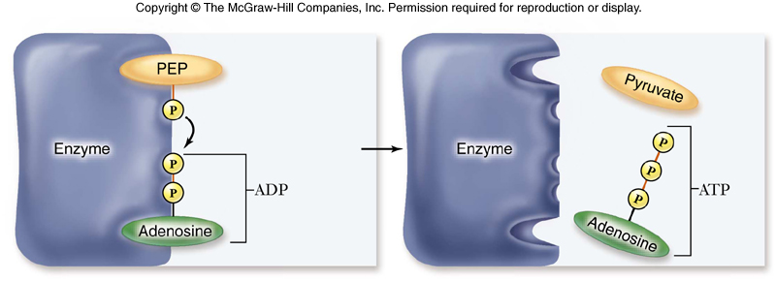

Slide 16
Oxidation of Glucose
The complete oxidation of glucose proceeds in stages:
1. glycolysis
2. pyruvate oxidation
3. Krebs cycle
4. electron transport chain & chemiosmosis

Slide 17
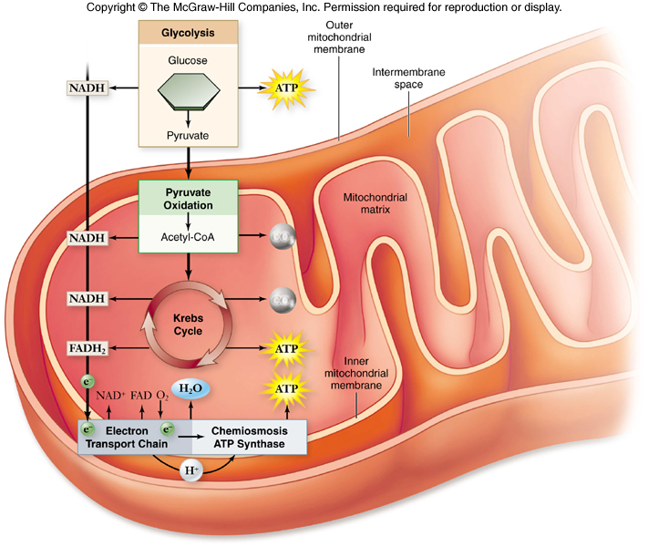

Slide 18
Glycolysis
Glycolysis converts glucose to pyruvate.
-a 10-step biochemical pathway.
-occurs in the cytoplasm.
-2 molecules of pyruvate are formed.
-net production of 2 ATP molecules by substrate-level phosphorylation
-2 NADH produced by the reduction of NAD⁺
For glycolysis to continue, NADH must be recycled to NAD⁺ by either:
a. aerobic respiration – occurs when oxygen is available as the final electron acceptor.
b. fermentation – occurs when oxygen is not available; an organic molecule is the final electron acceptor.
The fate of pyruvate depends on oxygen availability.
  When oxygen is present, pyruvate is oxidized to acetyl-CoA which enters the Krebs cycle.
  Without oxygen, pyruvate is reduced in order to oxidize NADH back to NAD⁺

Slide 19
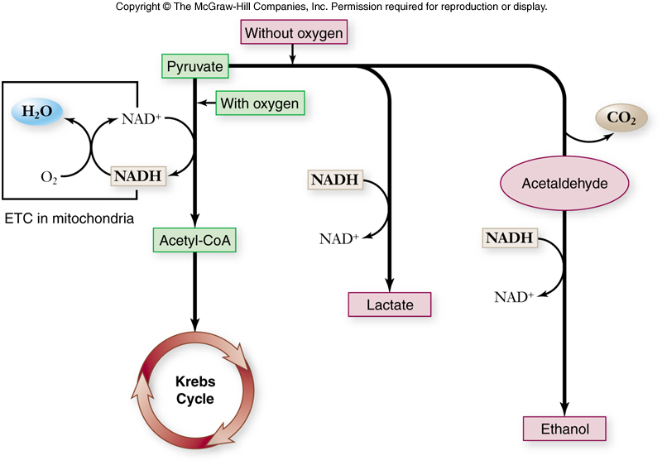

Slide 20
Pyruvate Oxidation
In the presence of oxygen, pyruvate is oxidized.
-occurs in the mitochondria in eukaryotes.
-occurs at the plasma membrane in prokaryotes.
-in mitochondria, a multienzyme complex called pyruvate dehydrogenase catalyzes the reaction.
The products of pyruvate oxidation include:
-1 CO₂
-1 NADH
-1 acetyl-CoA which consists of 2 carbons from pyruvate attached to coenzyme A (CoA).
Then, Acetyl-CoA proceeds to the Krebs cycle.

Slide 21
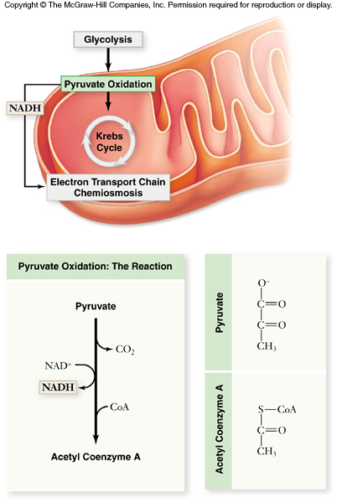
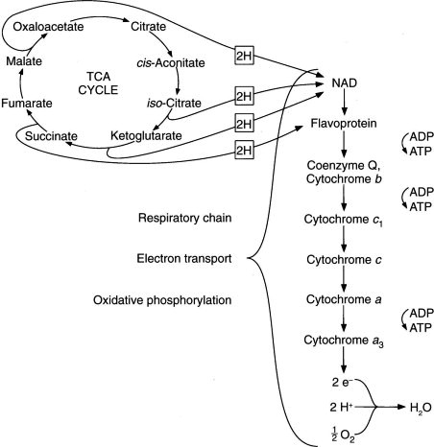

Slide 22
Krebs Cycle
The Krebs cycle oxidizes the acetyl group from pyruvate.
-occurs in the matrix of the mitochondria
-biochemical pathway of 9 steps
-first step:
acetyl group + oxaloacetate citrate
(2 carbons) (4 carbons) (6 carbons)
The remaining steps of the Krebs cycle:
-release 2 molecules of CO₂
-reduce 3 NAD⁺ to 3 NADH
-reduce 1 FAD (electron carrier) to FADH₂
-produce 1 ATP
-regenerate oxaloacetate

Slide 23
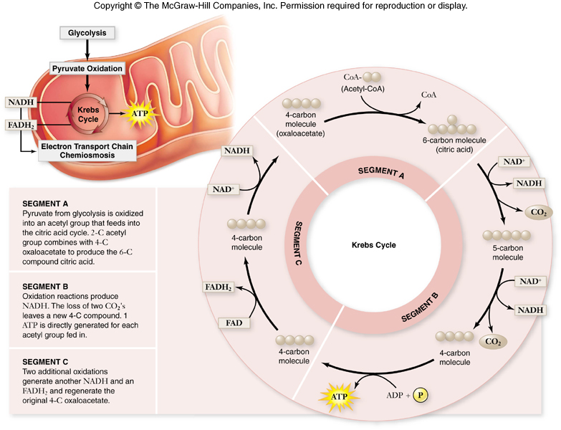

Slide 24
Krebs Cycle
After glycolysis, pyruvate oxidation, and the Krebs cycle, glucose has been oxidized to:
- 6 CO₂
- 4 ATP
- 10 NADH
- 2 FADH₂
These electron carriers proceed
to the electron transport chain.

Slide 25
Electron Transport Chain
The electron transport chain (ETC) is a series of membrane-bound electron carriers, also called terminal chain.
-embedded in the mitochondrial inner membrane.
-electrons from NADH and FADH₂ are transferred to complexes of the ETC.
-each complex transfers the electrons to the next complex in the chain.
As the electrons are transferred, some electron energy is lost with each transfer.
This energy is used to pump protons (H⁺) across the membrane from the matrix to the inner membrane space.
A proton gradient is established.

Slide 26
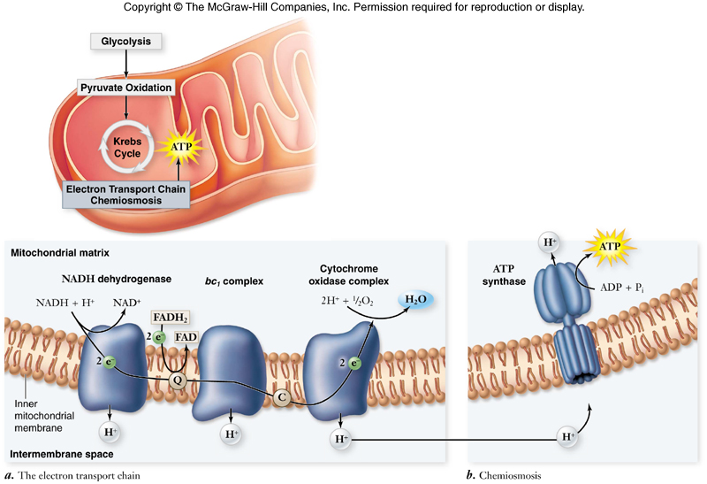
What is ETC?
The electron transport chain is a collection of proteins attached to inner mitochondrial membrane

Slide 27
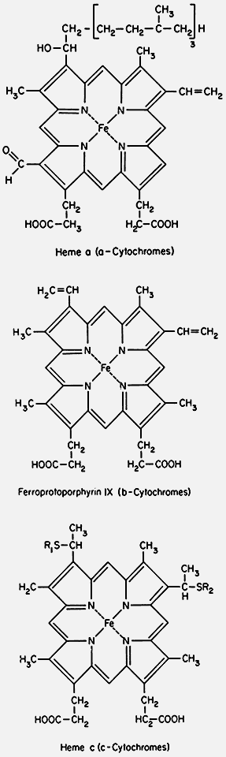
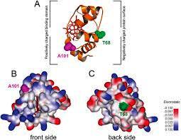
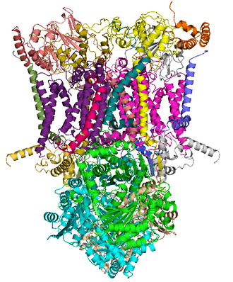
Types of mobile Electron carriers
The electron transport chain (ETC) is the major consumer of O2 in mammalian cells. The ETC passes electrons from NADH and FADH2 to protein complexes and mobile electron carriers. Coenzyme Q (CoQ) and cytochrome c (Cyt c) are mobile electroncarriers in the ETC, and O2 is the final electron recipient.
Cytochromes are divided into three main groups, the cytochromes-a,
-b, and -c. These correspond to heme-a, -b, and -c.
Heme-b may be regarded as the basic structure
Coenzyme Q – cytochrome c reductase

Slide 28
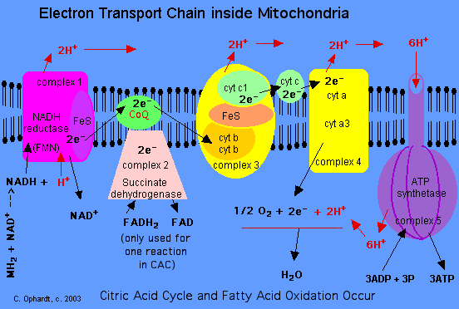
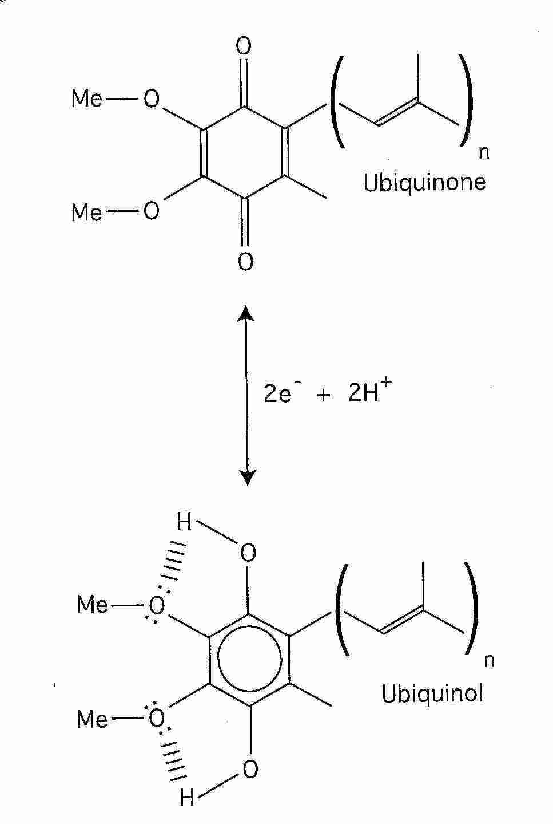
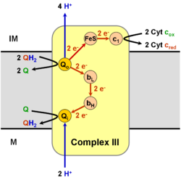
The coenzyme Q : cytochrome c – oxidoreductase, sometimes called the cytochrome bc₁ complex, and at other times complex III, is the third complex in the electron transport chain , playing a critical role in biochemical generation of ATP (oxidative phosphorylation).

Slide 29
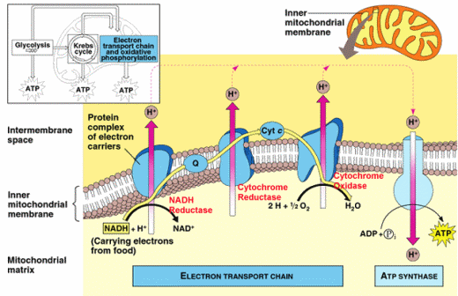
Final Third Stage or terminal chain
Electron Transport Chain

Slide 30
Electron Transport Chain
The higher negative charge in the matrix attracts the protons (H⁺) back from the intermembrane space to the matrix.
The accumulation of protons in the intermembrane space drives protons into the matrix via diffusion.
Most protons move back to the matrix through ATPsynthase.
ATP synthase is a membrane-bound enzyme that uses the energy of the proton gradient to synthesize ATP from ADP + P_{i}

Slide 31
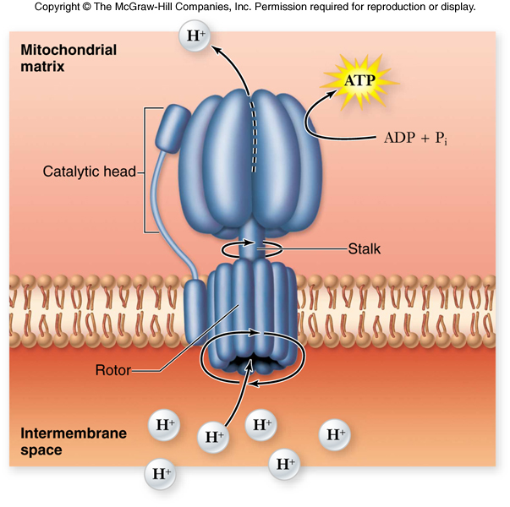
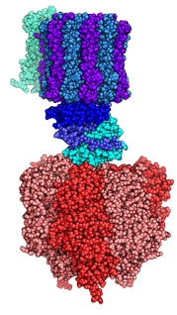

Slide 32
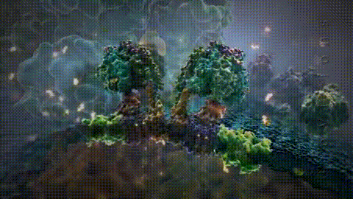
Role of ATP Synthase
The bulk of ATP produced is because of ATP synthase (a membrane protein).
ATP synthase is driven by the return flow of H+ ions across the mitochondrial membrane.
This return flow of H+ ions rotates part of the membrane protein,
ATP synthase, catalysing the synthesis of ATP.
Watch the lower part of the protein as it rotates round because H+ ions pass through it!

Slide 33
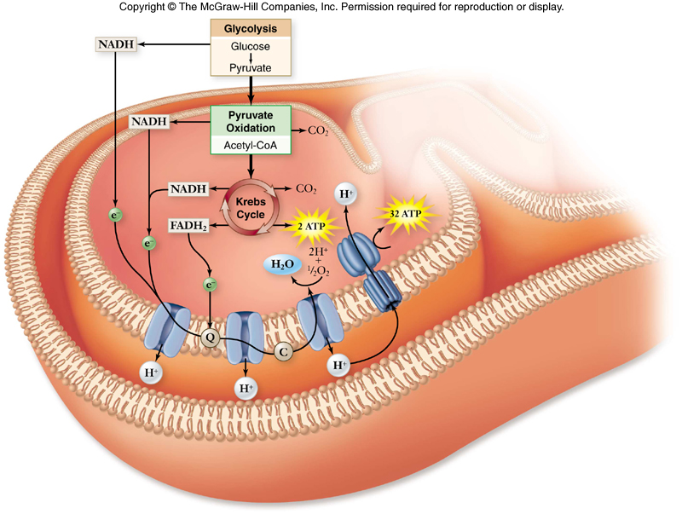
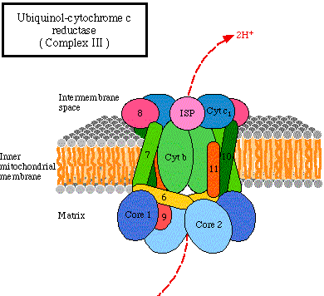

Slide 34
Energy Yield of Respiration
theoretical energy yields
- 38 ATP per glucose for bacteria
- 36 ATP per glucose for eukaryotes
actual energy yield
- 30 ATP per glucose for eukaryotes
- reduced yield is due to “leaky” inner membrane and use of the proton gradient for purposes other than ATP synthesis

Slide 35
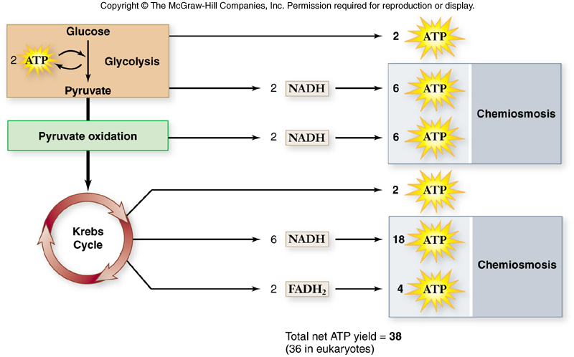

Slide 36
Electron Transport Chain
3 things to note:
MOVEMENT OF ELECTRONS
  High energy electrons pass from one protein molecule in the chain to another
MOVEMENT OF HYDROGEN IONS
  The energy received allows the proteins to pump hydrogen across the membrane, so that they can be pumped back across by ATP synthase.
  This movement of H+ ions drives the enzyme to synthesise ATP from ADP + Pi
PRODUCTION OF WATER
  When electrons come to the end of the chain, they combine with oxygen (the final electron acceptor).
  The oxygen then combines with hydrogen to form water.

Slide 37
The electron transport chain is a collection of proteins attached to a membrane.
As a result of dehydrogenase enzyme action during glycolysis and the citric acid cycle, hydrogen ions and electrons are removed and passed on to the coenzymes NAD or FAD to form NADH or FADH2.
NADH and FADH2 release the high-energy electrons to the electron transport chain where they pass along the chain, releasing energy.
The energy is used to pump H ions across the inner mitochondrial membrane.
The return flow of H ions drives ATP synthase and produces the bulk of the ATP generated by cellular respiration.
Notes:
This is a handout

Slide 38
Regulation of Respiration
Regulation of aerobic respiration is done by feedback inhibition.
-a step within glycolysis is allosterically inhibited by ATP and by citrate
-high levels of NADH inhibit pyruvate dehydrogenase
-high levels of ATP inhibit citrate synthetase

Slide 39
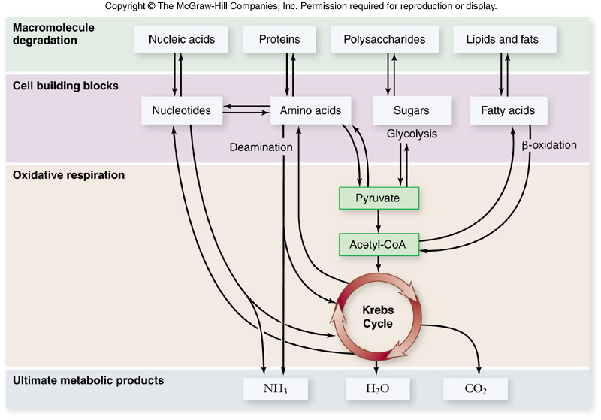

Slide 40
Evolution of Metabolism
A hypothetical timeline for the evolution of metabolism in following 6 steps:
1. ability to store chemical energy in ATP
2. evolution of glycolysis
3. anaerobic photosynthesis (using H₂S)
4. use of H₂O in aerobic photosynthesis (using O_{2 ;} not H₂S)
5. evolution of nitrogen (N₂) fixation
6. aerobic respiration evolved most recently

